Slide 1



DEPARTMENT OF ELECTRICAL AND ELECTRONICS ENGINEERING
EEB1204 - ELECTRON DEVICES AND CIRCUITS
FINAL REVIEW
SMART BUS STOP
YEAR/ SEMESTER – II/III
BATCH NUMBER : 6
DATE :13-12-2025
PRESENTED BY:
DEEPAK S (927624BEE014)
BHARATHKUMAR M (927622BEE013)
BHARATH G (927622BEE012)
DHANIKESH S (927624BEE017)
DEEPAN S (927624BEE015)
GUIDED BY:
Dr.S.Banumathi, M.E., Ph.D,
Professor /EEE
Mr.N.Selvam, M.E., AP/EEE

Slide 2
ABSTRACT
A smart bus stop is a technology-enabled transportation hub designed to provide passengers with safety, convenience, and real-time information. traditional bus stops lack basic facilities such as reliable timetables, lighting, and security, which creates inefficiencies and safety concerns. to address these issues, the proposed smart bus stop incorporates solar power, real-time bus tracking, digital display systems, emergency alert modules, mobile charging facilities, and cctv surveillance.The use of solar panels ensures sustainable operation even in rural or remote areas, while the gps-based real-time tracking system provides accurate bus arrival information to passengers. an emergency alert button enhances security by sending notifications to nearby authorities in case of danger. additional features such as usb charging ports, free wi-fi, and voice-assisted announcements improve the overall user experience and ensure accessibility for different categories of passengers.This smart bus stop model promotes green energy utilization, passenger safety, and digital connectivity, making it suitable for both urban smart city projects and rural public transport development. the project aims to transform conventional bus stops into intelligent, sustainable, and user-friendly mobility hubs.

Slide 3
INTRODUCTION
In rural and semi-urban areas, proper lighting is essential for ensuring safety, security, and usability of public spaces such as bus stops, streets, and community centers. however, conventional lighting systems consume significant energy and require manual operation, often leading to wastage of electricity or inadequate illumination at night. To overcome these challenges, an automatic night lighting system is proposed. the system uses a light dependent resistor (ldr) as a sensor to detect ambient light levels. when natural light decreases below a certain threshold (nighttime or cloudy weather), the system automatically switches on the lamp. during the daytime, when sufficient sunlight is available, the system switches off the lamp to conserve energy. This project can be implemented using an arduino microcontroller, ldr sensor, relay, and lamp, ensuring a low-cost, energy-efficient, and reliable lighting solution for rural bus stops, streets, and public areas.

Slide 4
PROBLEM STATEMENTS
1. Lack of night lighting.
2. Safety risks for women, children.
3. No digital or smart infrastructure.
4. No passenger feedback and absence of real-time passenger data.
5. Energy wastage from grid- powered.
6. Absence of timetable or bus availability information.
7. Lack of cleanliness and waste management.

Slide 5
CORE FEATURES
Real-time bus tracking .
LED/LCD display showing live bus arrival times.
GPS-integrated system with vehicles.
Solar power system.
USB mobile charging ports.
Emergency or unusual activity detection system.
Automatic night lighting.
Destination display for drivers.
GSM communication.
Integrating card-based ticket.

Slide 6
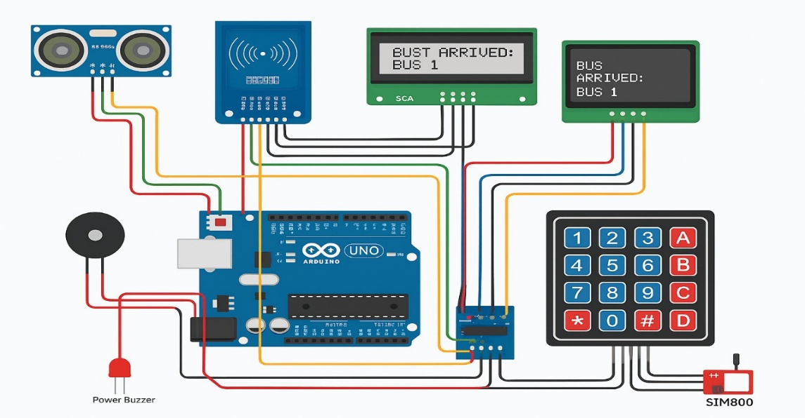
CIRCUIT DIAGRAM
ULTRASONIC SENSOR

Slide 7
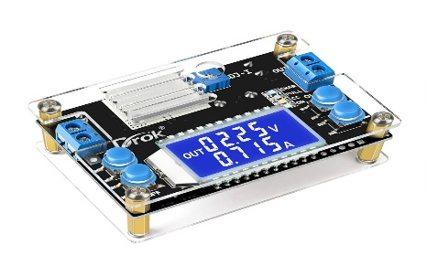
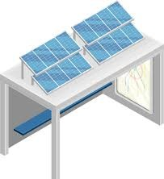
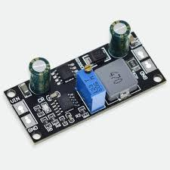
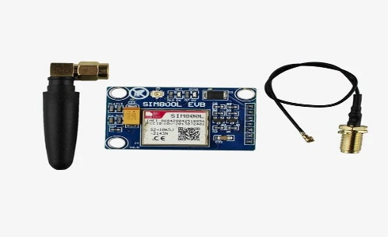
COMPONENTS USED
COMPONANTS:
1.SOLAR PANEL:
3. VOLTAGE CONTROLLER:
2. CHARGE CONTROLLER:
4. GSM MODULE:

Slide 8


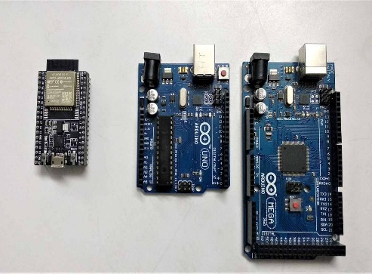
COMPONENTS USED
5. EMERGENCY PUSH BUTTON:
6. BATTERY:
7. MICROCONTROLLER:

Slide 9
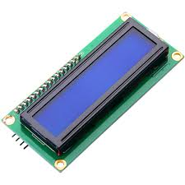
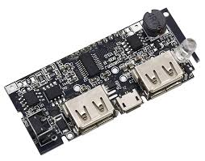
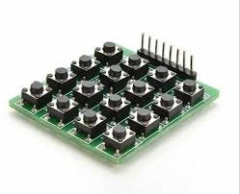
COMPONENTS USED
9. 16x2 LED OR OLED DISPLAY:
10. USB Port Module :
11. KEYPAD(Buttons for ticket):

Slide 10

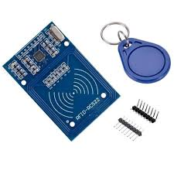
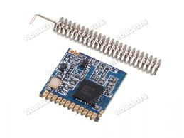
COMPONENTS USED
13. Buzzer (Optional feedback):
14. 21RFID MODULE (RC522):
15. LORA SX1278 MODULE:

Slide 11
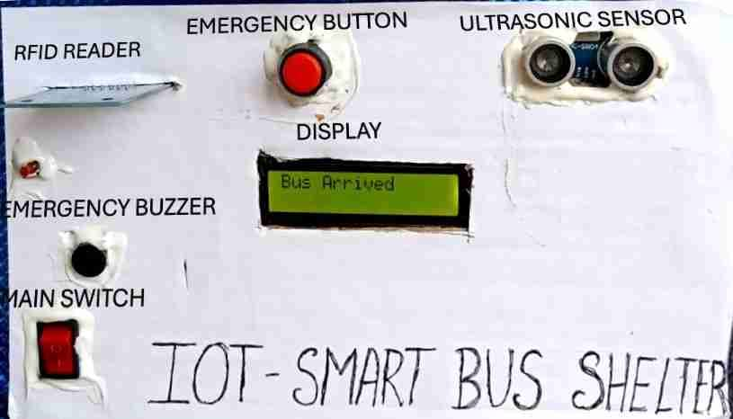
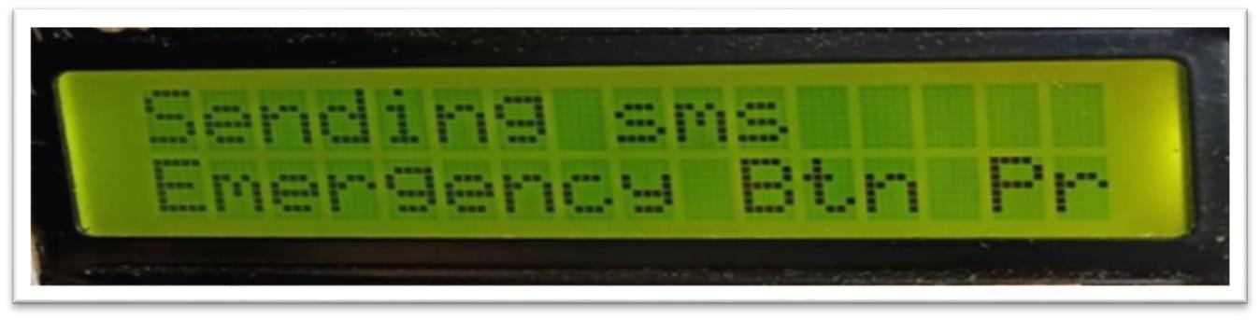

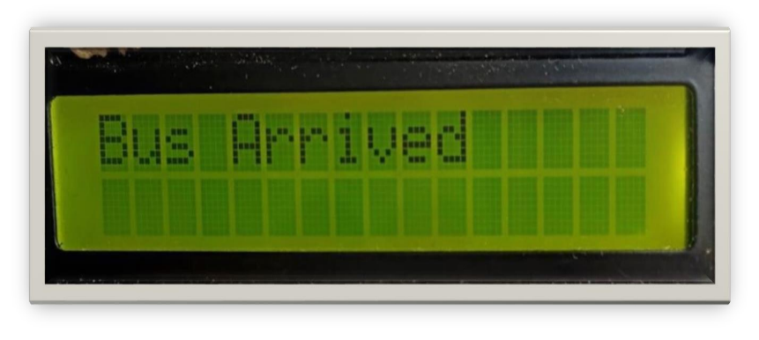
HARDWARE OUTPUT
MAIN PANEL
TICKET DISPLAY
EMERGENCY DISPLAY
BUS ARRIVE DISPLAY

Slide 12
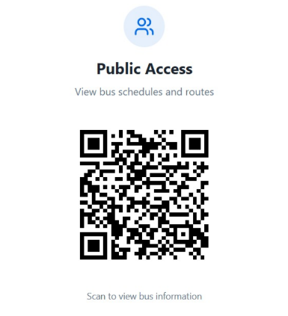
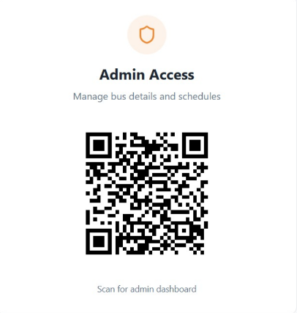
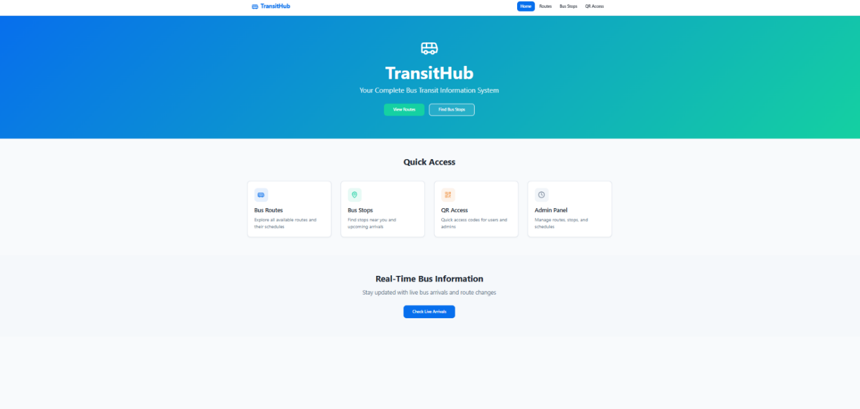
SOFTWARE OUTPUT
The QR Code for Public: The QR Code For Admin:
Main Dashboard:

Slide 13
BENEFITS
Sustainable Power Usage:
Operates entirely on solar energy, reducing dependency on the power grid and supporting clean, renewable energy goals.
Real-Time Bus Information
Displays live bus arrival and departure times, reducing passenger waiting anxiety and improving time management.
Smart Authentication & Ticketing
RFID-based system enables automatic bus detection and contactless passenger identification, ensuring faster and cashless ticketing.
Enhanced Passenger Safety
Emergency alert system (button + keypad) allows passengers to immediately contact authorities during emergencies.
Efficient IoT Connectivity
IoT modules ensure seamless communication between the shelter, buses, and control centers for data updates and monitoring.
Passenger Convenience & Comfort
Provides weather updates, notifications, and smart lighting, making travel more convenient and user-friendly.
Eco-Friendly and Cost-Effective
Minimizes electricity bills and carbon footprint, supporting a sustainable public transport ecosystem.

Slide 14
FUTURE SCOPE
Integration with Mobile Applications – Passengers can receive real-time bus arrival notifications and alerts directly on their smartphones, enabling better trip planning.
Advanced Sensor Technologies – Incorporating infrared or camera-based sensors can improve accuracy in detecting buses and passenger presence, even in crowded or low-light conditions.
Solar-Powered Operation – Implementing solar panels can make the system energy-efficient and self-sustaining, reducing dependency on external power sources.
Internet of Things (IoT) Connectivity – Connecting bus stops to a central server allows for real-time monitoring, data analytics, and predictive maintenance of buses and stop infrastructure.
Voice Assistance and AI Integration – Voice notifications and AI-based predictive features can further enhance passenger convenience, especially for visually impaired individuals.
Emergency Management Features – The system can be integrated with local authorities to provide automatic alerts in case of accidents, delays, or security threats.
Scalability for Smart Cities – The system can be expanded across multiple bus stops in a city, forming an interconnected network for efficient traffic management and passenger information.

Slide 15
CONCLUSION
The proposed smart bus stop system provides an innovative, technologically advanced solution to modernize rural and urban transport infrastructure. By utilizing solar energy, smart card ticketing, emergency alerts, and real-time information displays, this system ensures passenger safety, enhances commuter convenience, and promotes green energy usage. It addresses the common challenges faced at traditional bus stops and introduces an affordable, scalable model that can be implemented in smart cities and smart villages across the country. This project not only improves the functionality of public transport but also contributes to a safer, cleaner, and more connected community.

